Slide 1
Translating the evidence
CDS 663
March 9, 2021

Slide 2
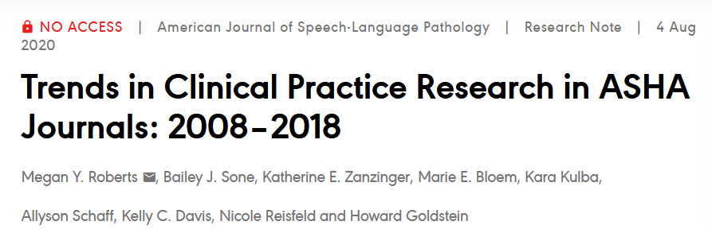
What do we know about the type of research being published?

Slide 3
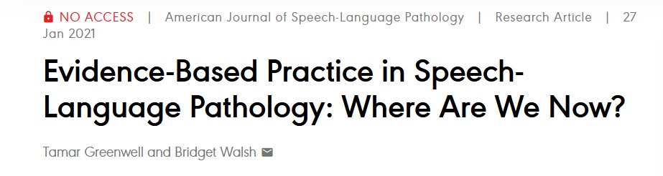
Why talk about this?
“Exposure to EBP in graduate school and during the CF, perception of barriers, and EBP career training significantly predicted the use of EBP in clinical practice.”

Slide 4
Translating evidence: a good starting point?
Systematic reviews
Provide overview of research trends
Practice guidelines
Starting point for finding an article

Slide 5
What should clinicians know about reading research?
Clinical implications section
Framework for analyzing utility
Assessment
Intervention
Medical knowledge or diagnosis
Service delivery / Interprofessional practice

Slide 6
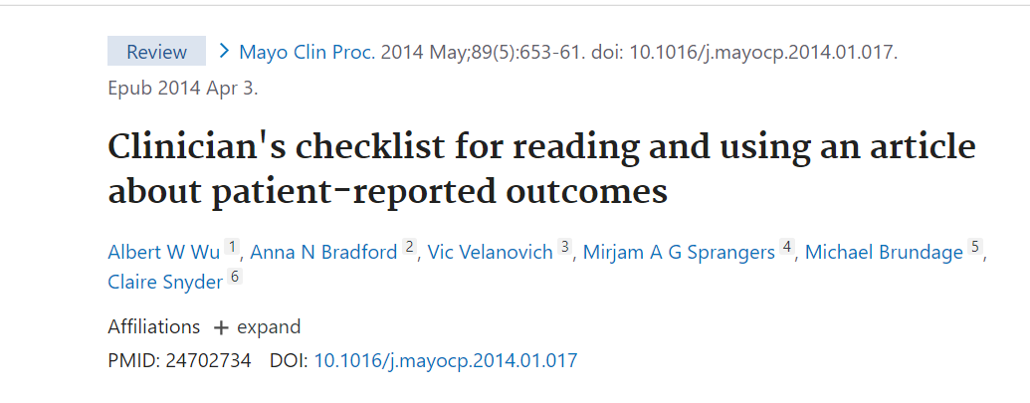
Evidence-based checklists

Slide 7

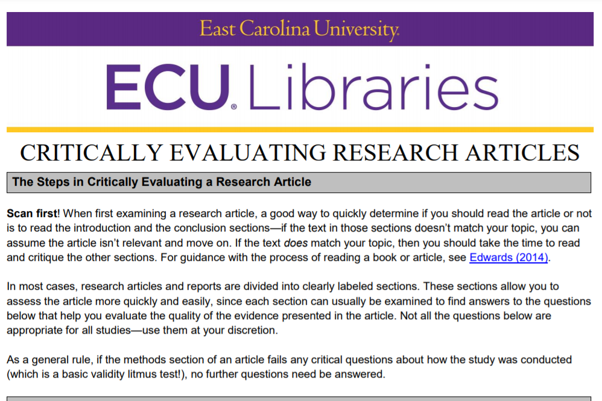
Evidence-based checklists

Slide 8
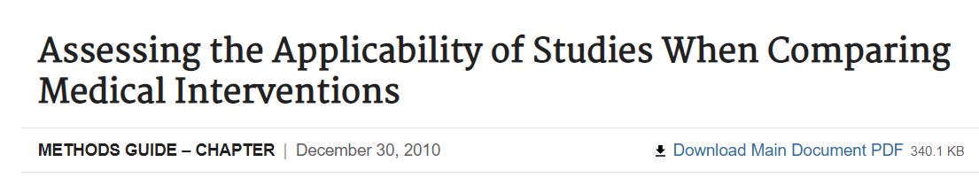
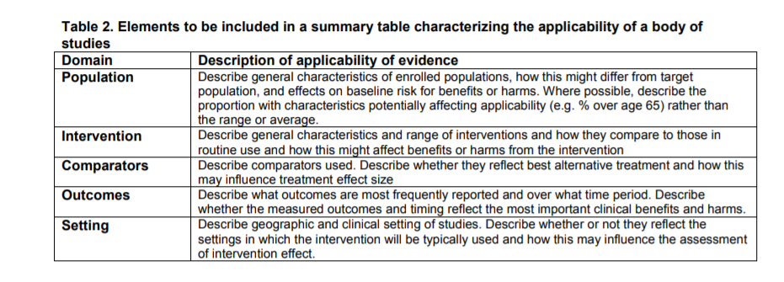
EVIDENCE-BASED GUIDELINES ON JUDGING RESEARCH APPLICABILITY

Slide 9
Putting into practice
Let’s evaluate the clinical utility of some papers!

